Slide 1
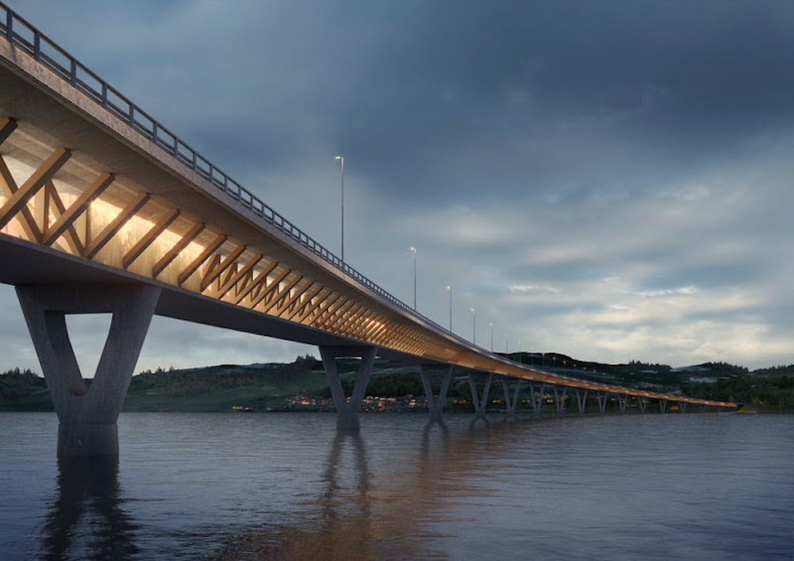

Detection of Surface Cracks in
Concrete Infrastructures Using
Deep Learning
Dr Nariman Saeed
1 December 2020

Slide 2




Data Scientist
Help you leverage AI at your firm
University Lecturer
PhD in Structural Engineering
Strong Knowledge in Mathematics, Statistics and Reliability
Skills:
PROGRAMMING: Python| MatLab
DATABASE: SQL
DATA VISUALISATION: Matplotlib | seaborn
LIBRARIES: Pandas | NumPy | Scikit Learn | SCIPY
ALGORITHMS FOR MODELLING (AI): Supervised and Unsupervised Learning | Clustering , Regression and Classification| Artificial Neural Network | Deep Learning | Feature Extraction | Feature Selection & Weighting
Web Scrapping
Narim.saeed@gmail.com
https://www.linkedin.com/in/narimansaeed/
2

Slide 3
OUTLINE
Introduction
Definition
Design
Delivery
Summary
Conclusion
+
Next Steps
3

Slide 4
Introduction
Definition
Design
Delivery
summary
Conclusion
+
Next steps
4

Slide 5

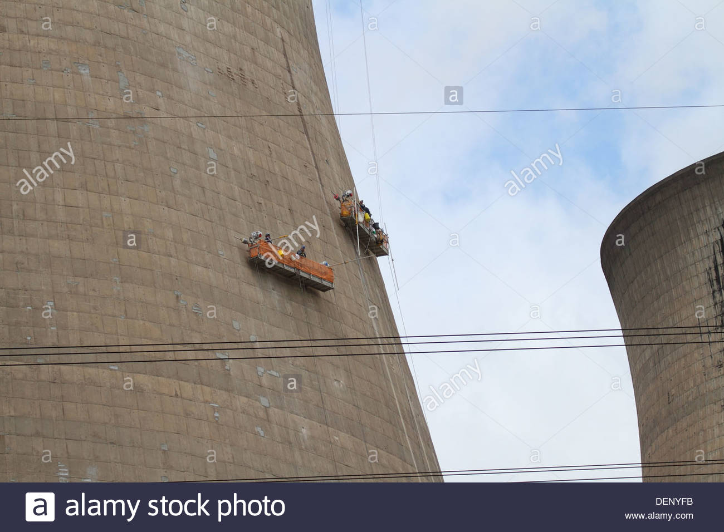
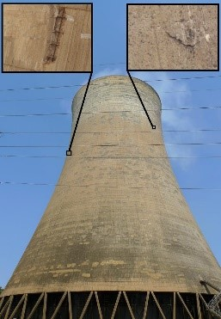
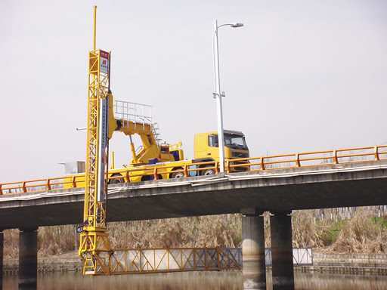
Manual Inspection is:
Human dependent
Not safe at height and not easily accessible areas
Could be deliberately neglected
INTRODUCTION
5

Slide 6

Photography
INTRODUCTION
INTRODUCTION
6
6

Slide 7
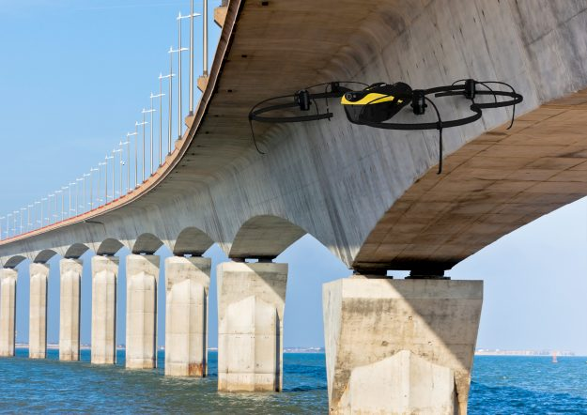
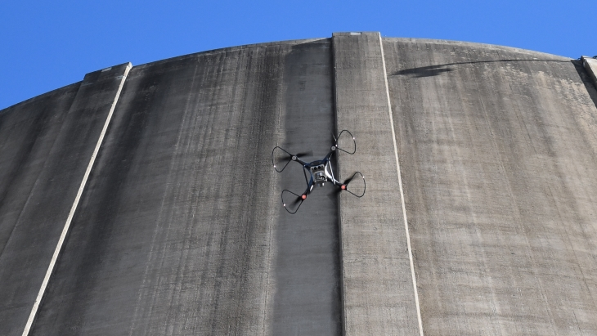
INTRODUCTION
7

Slide 8

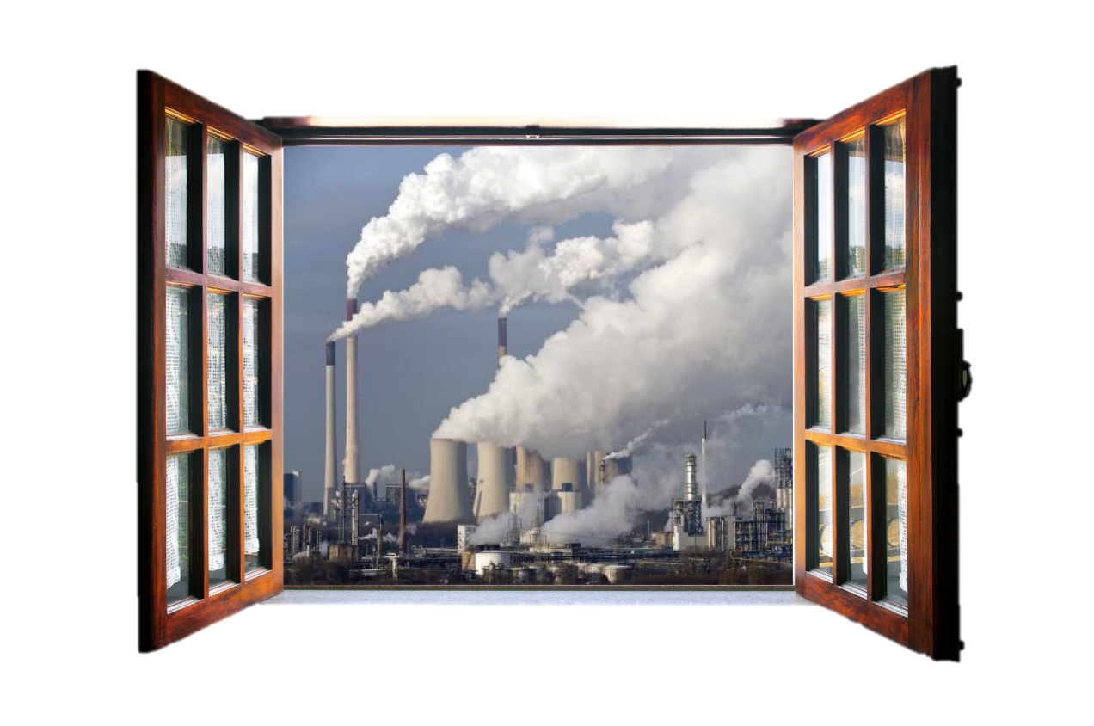
Human Error
Neglection
Safety Issue
8

Slide 9
Introduction
Definition
Design
Delivery
summary
Conclusion
+
Next steps
9

Slide 10
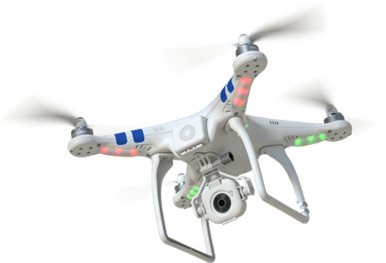
Asset Owners
Consultants
QA/QC units
Maintenance planners
DEFINITION
10

Slide 11


How can reduce safety risk in visual inspection of difficult to access RC elements while minimising human related errors? “Killing two birds with one stone” ☺
What is the best Deep Learning algorithm for this Image Processing concept?
Business Question
Data Question
11
DEFINITION

Slide 12
Introduction
Definition
Design
Delivery
summary
Conclusion
+
Next steps
12

Slide 13



DATA
Modelling
Solution
4,000 RGB photos
of cracked and uncracked surfaces.
Balanced data
Developing, Training and Evaluating models using CNN architectures
An Accurate Model Enables the stake-holder to detect cracked concrete surfaces based on images
DESIGN
13

Slide 14
Introduction
Definition
Design
Delivery
summary
Conclusion
+
Next steps
14

Slide 15
LeNet
Resnet50
CNN with Avgepooling
CNN with Maxpooling
DELIVERY
15

Slide 16
LeNet
Resnet50
CNN with Avgepooling
CNN with Maxpooling
DELIVERY
16

Slide 17
13s
53s
57s
78s
LeNet
AvgPooling
MaxPooling
Resnet50
DELIVERY
17

Slide 18
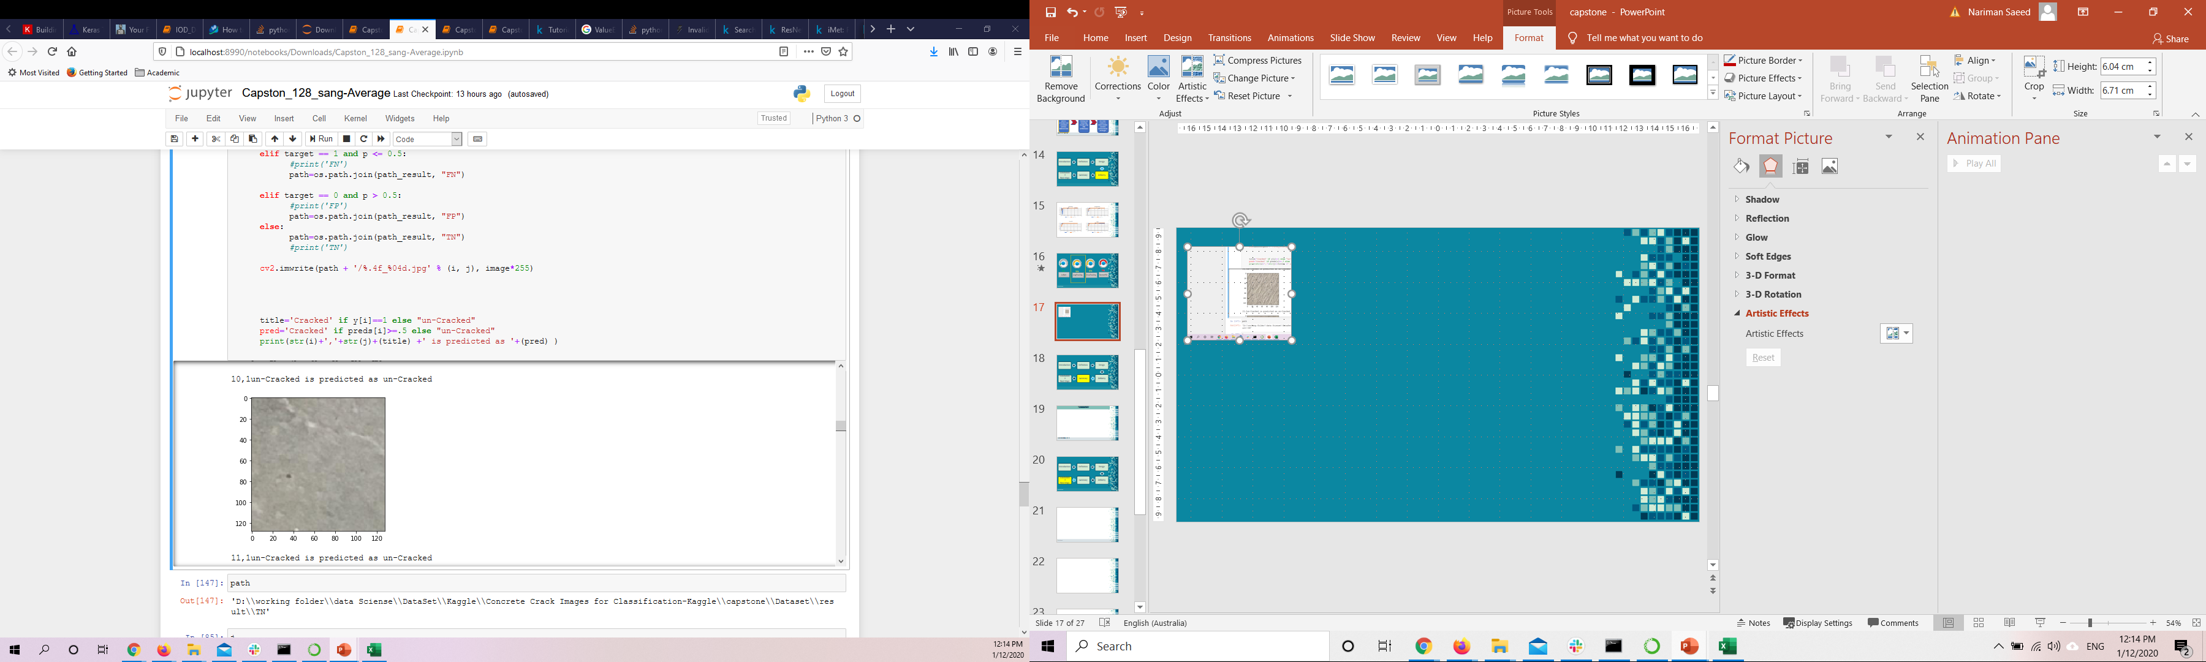
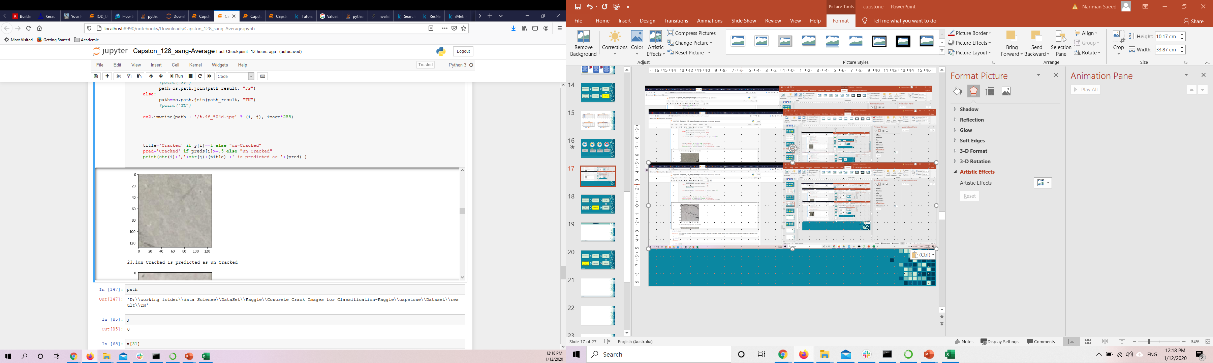
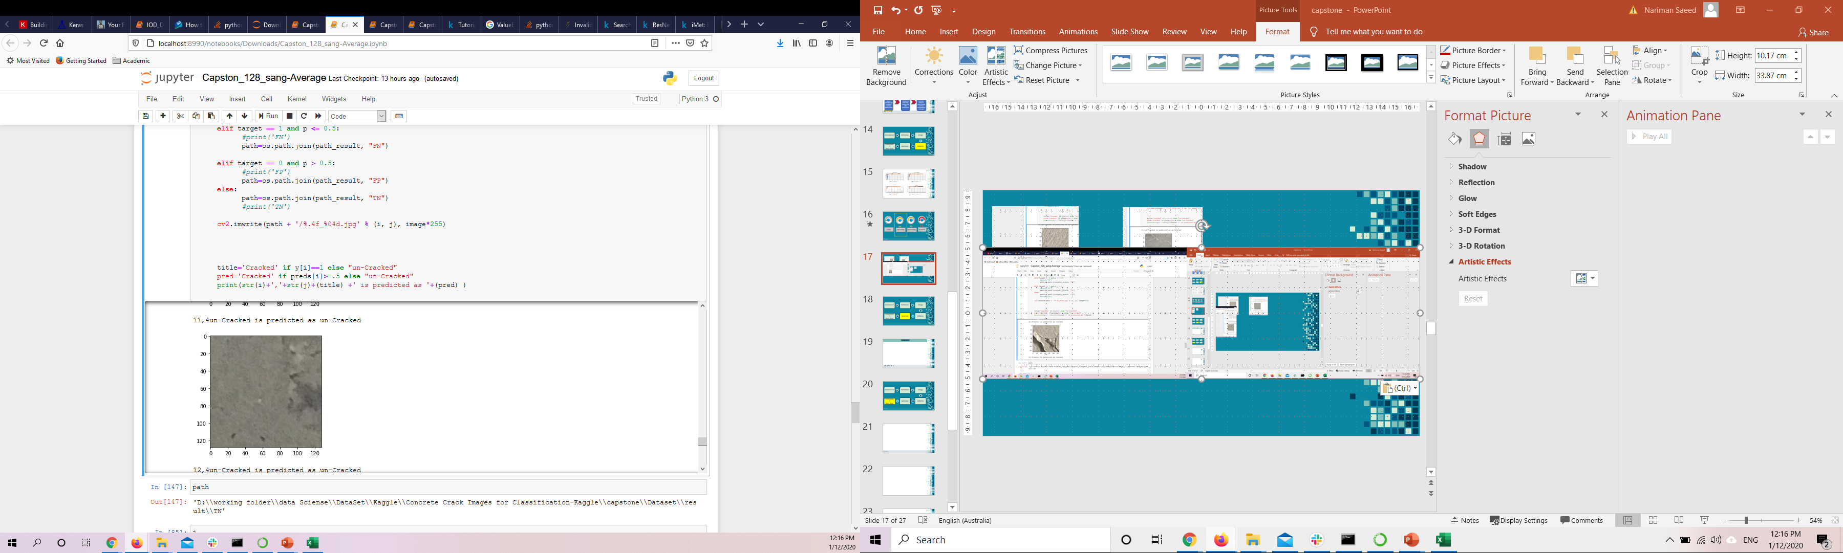
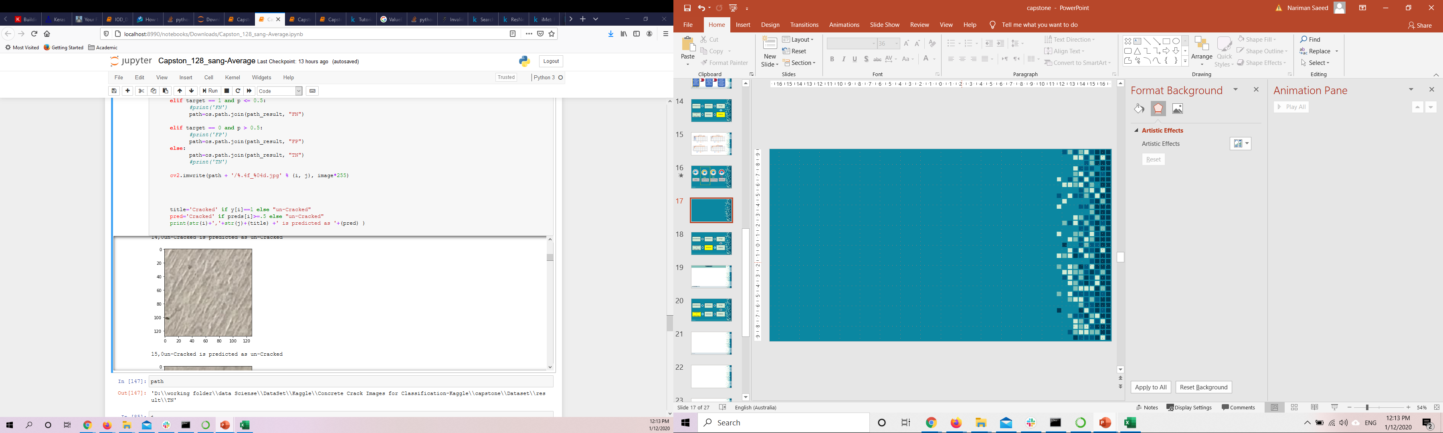
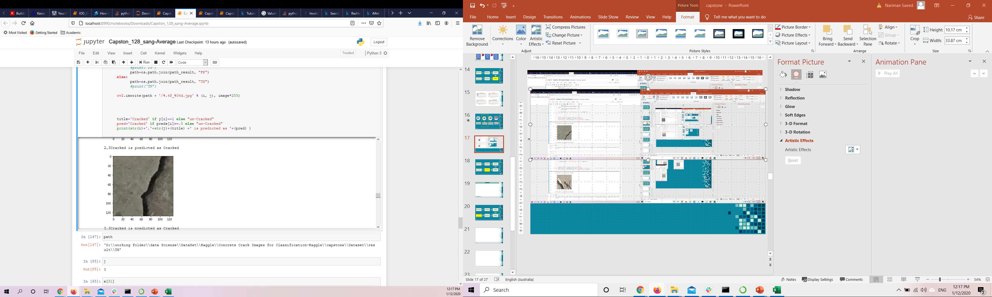

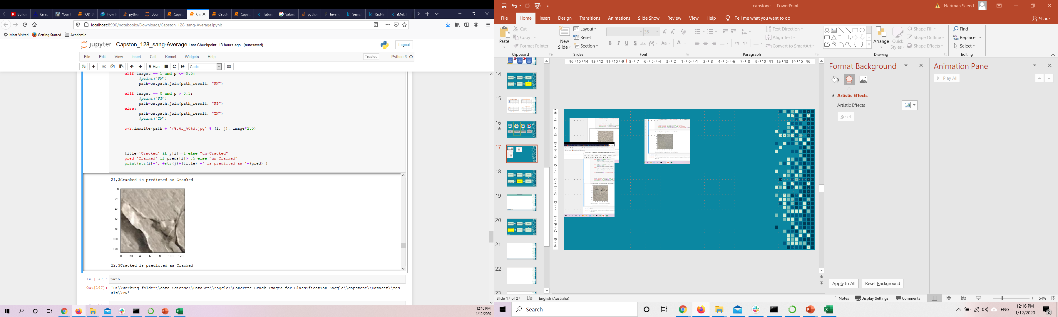
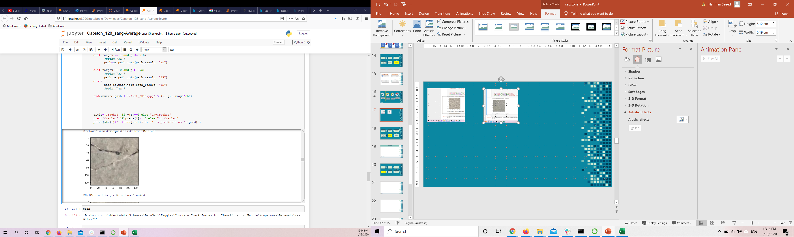
DELIVERY
18

Slide 19
Introduction
Definition
Design
Delivery
Summary
Conclusion
+
Next steps
19

Slide 20
SUMMARY
1
2
3
Four Different CNN architects were chosen/developed. Trained using 3400 random RGB photos
of cracked and uncracked surfaces and evaluated against 480 random phots. The most accurate fastest one was selected
The selected Model successfully predicted random photos.
A model is ready to utilise for RC infrastructures Inspection.
Clients will use this model for prediction of the cracks.
Safe, Fast and accurate.
Yes!
multiple birds are killed by one stone
SUMMARY
20

Slide 21
Introduction
Definition
Design
Delivery
summary
Conclusion
+
Next steps
21

Slide 22
Conclusion
Next Step
Using AI in the field of Reinforced Concrete Infrastructure maintenance and rehabilitation is demonstrated. Visual inspection of tall and problematic structures is made easy now.
Development of a code to chop the taken photos into the proper size for this prediction.
Detecting the width and the length of cracks
Considering Real time image segmentation
Conclusion
22

Slide 23
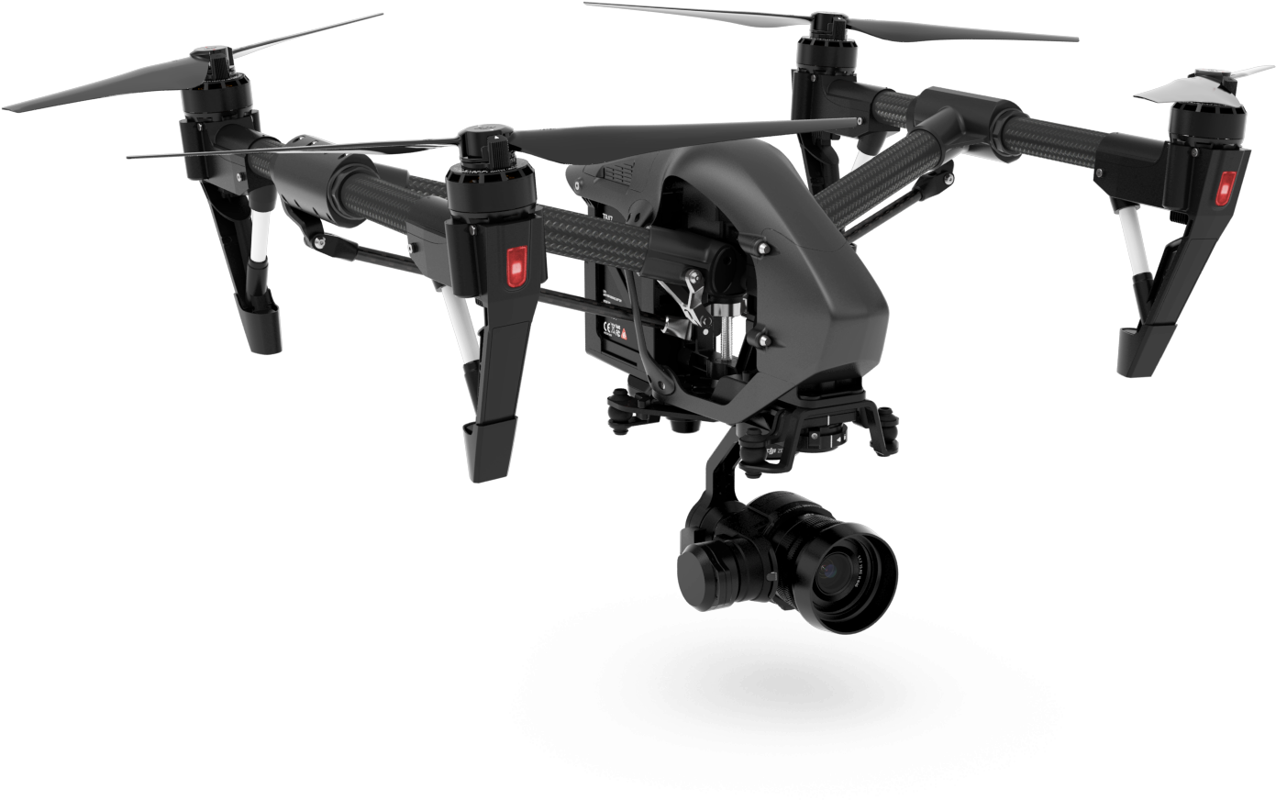
Thanks for your time
Any question?
23
23

